Slide 1
Interaction Diagrams
Part II: Communication Diagram

Slide 2
3 basic building blocks of UML - Diagrams
Graphical representation of a set of elements.
Represented by a connected graph: Vertices are things; Arcs are relationships/behaviors.
5 most common views built from
UML 1.x: 9 diagram types.
UML 2.0: 12 diagram types
Structural Diagrams
Represent the static aspects of a system.
  Class;
  Object
  Component
  Deployment
Structural Diagrams
  Class;
  Object
  Component
  Deployment
  Composite Structure
  Package
Behavioral Diagrams
Represent the dynamic aspects.
  Use case
  Sequence;
  Collaboration
  Statechart
  Activity
Behavioral Diagrams
  Use case
  Statechart
  Activity
Interaction Diagrams
  Sequence;
  Communication
  Interaction Overview
  Timing

Slide 3
Interaction Diagrams (sd and cd)
show the interaction of any kind of instance (classes, interfaces, components, nodes and subsystems);
messages sent/received by those objects/instances (invocation, construction/destruction, of an operation)
realizes use cases to model a scenario
Interaction types (these are isomorphic, when no loops or branching)
  Sequence diagram —emphasizes the time ordering of messages.
  Communication (Collaboration) diagram — emphasizes the structural organization of objects that directly send and receive messages.
Objects within an interaction can be:
  Concrete: something from the real world. (e.g., John: Person)
  Prototypical: representative instance of something from the real world
  (e.g., p: Person)
    Communication diagrams use (strictly) prototypical things.
    Prototypical instances of interfaces and abstract types are valid.

Slide 4
Interaction Diagram: sequence vs communication
objects
p : StockQuotePublisher
s1 : StockQuoteSubscriber
s2 : StockQuoteSubscriber
object
role:ClassName
classifiers or their instances,
use cases or actors.
attach(s1)
attach(s2)
Procedure call, RMI, JDBC, …
Observer
design
pattern
Time
notify()
update()
{update < 1 minutes}
Activations (See pg 14)
- Show duration of execution
- Shows call stack
- Return message
  Implicit at end of activation
  Explicit with a dashed arrow
getState()
update()
getState()
3 : notify()
4 : update()
s1 : StockQuoteSubscriber
1 : attach(s1)
6 : getState()
p : StockQuotePublisher
5 : update()
s2 : StockQuoteSubscriber
2 : attach(s2)
7 : getState()

Slide 5
Interactions - Modeling Actions
Simple
Call
Return
Send
asynchronous in 2.0 (stick arrowhead) – no return value expected at end of callee activation
activation of caller may end before callee’s (???)
half arrow in 1.x
c : Client
1
p : PlanningAgent
: TicketAgent
<<create>>
actual parameter
setItenerary( i )
calculateRoute()
loop
return
route
return value
call on self
for each conference
<<destroy>>
X
end of object life
notify()
send
destroy: e.g., in C++ manual garbage collection; in Java/C#, unnecessary
natural death/
self destruction
Additional considerations
To show nested messages, use ?.
To show constraints like time and space, use ?.
For formal flow of control, attach pre and post conditions to each message (?)

Slide 6
linking sequence diagrams
Sequence Diagrams – Generic vs. Instance
2 forms of sd:
  Instance sd: describes a specific scenario in detail; no conditions, branches or loops.
  Generic sd: a use case description with alternative courses.
ob3:C3
ob3:C3
ob3:C3
ob3:C3
op1
ob1:C1
[x>0] foo(x)
ob2:C2
concurrent lifelines
for conditionals
for concurrency
conditional
[x<0] bar(x)
do(z)
do(w)
[z=0] jar(z)
[z=0] jar(z)
recurse()
recursion
Here, conditional or concurrency?

Slide 7
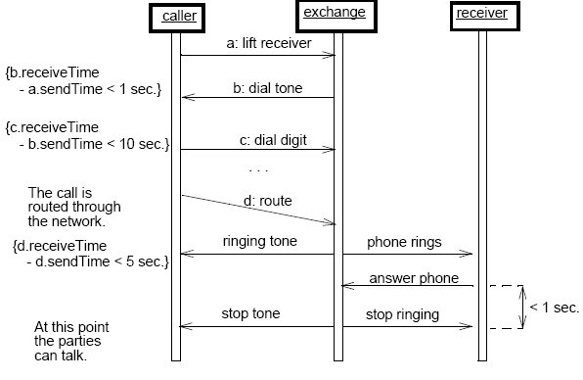
Timing constraints
Useful in real-time applications
useful to specify race condition behaviour
Two ways to specify (in 1.x)
any example?

Slide 8
Interactions - Procedural Sequencing vs. Flat Sequencing
Flat Sequencing
Infrequent: Not recommended for most situations.
Each message is numbered sequentially in order of timing.
Rendered with stick arrowhead.
Procedural Sequencing
(Dewey decimal system)
Most common.
Each message within the same operation is numbered sequentially.
Nested messages are prefixed with the sequence number of the invoking operation.
Rendered with filled solid arrow.
x
y
x
x.k
c : Client
c : Client
1
2
4
5
6
8
9
1
2
1.1
1.2
3.1
1.1.1
1.1.2
7
3.1.1
3
3
CAN’T TELL RELATIONSHIPS

Slide 9
Interactions – conditional paths, asynchronous message
[Craig Larman] [http://www.phptr.com/articles/article.asp?p=360441&seqNum=6&rl=1]
unconditional
:E
1a and 1b are mutually
exclusive conditional paths
2: msg7
1: msg1
a.2:update( p )
:A
1a [test1]:msg2
:B
:F
1b [not test1]:msg3
1c: msg4
a.1:<<create>>
asynchrous message
1c.1: msg5
:C
:D
active object
Is this ok?
Can you produce a corresponding sd?
Is there a unique sequence of paths?

Slide 10
Modeling Different Levels of Abstraction
Establish trace dependencies between high and low levels of abstraction
Loosely couple different levels of abstraction
  Use Cases trace to Collaborations in the Design Model, to a society of classes
  Components trace to the elements in the design model, then to Nodes
Interaction Diagram at a High Level of Abstraction
model
Use Case
: Order Taker
: Order
<<trace>>
: Order Clerk
Fulfillment
submitOrder
placeOrder
Order Clerk
acknowledgeOrder
Place Order
<<trace>>
Interaction Diagram at a Lower Level of Abstraction
: Order Taker
: CreditCard
: Order
: Billing Agent
: Order Clerk
Agen
Fulfillment
submitOrder
processCard
placeOrder
triggerBill
acknowledgeOrder

Slide 11
Sequence Diagrams & Some Programming
:Selection
:Purchase
purchase
buyMajor
buyMinor
create(cashTender)
:Payment
public Class Selection
{ private Purchase myPurchase = new Purchase();
private Payment myPayment;
public void purchase()
{ myPurchase.buyMajor();
myPurchase.buyMinor():
myPayment = new Payment( cashTender );
//. .
}
// . .
}

Slide 12
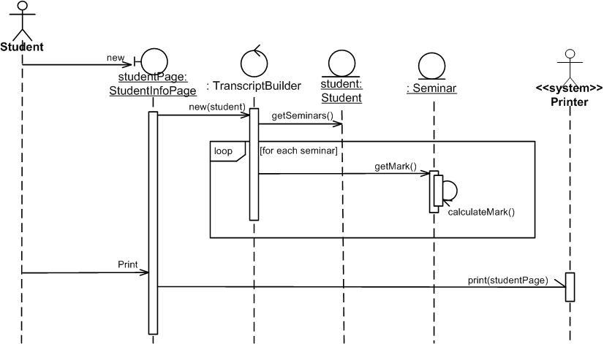
What can be in the top boxes?
(http://www.agilemodeling.com/artifacts/sequenceDiagram.htm)
Outputting transcripts
Boundary/interface elements: software elements such as screens, reports, HTML pages, or system interfaces that actors interact with.
Control/process elements (controllers): These serve as the glue between boundary elements and entity elements, implementing the logic required to manage the various elements and their interactions. Often implemented using objects, but simple ones using methods of an entity or boundary class.
Entity elements

Slide 13
State Transition Diagrams
Behavioral Diagrams
  Use case
  Statechart
  Activity
Interaction Diagrams
  Sequence;
  Communication
  Interaction Overview
  Timing

Slide 14
State Transitions
State machine - event-ordered behavior that specifies the sequences of states an object/instance (of class/interface/collaboration/…/system) goes through during its lifetime; events trigger transitions and cause responses.
(StateChart is one particular kind of state machine by David Harel)
State - condition or situation during which an object/instance may perform some activity; The state of an object is characterized by the value of one or more of its attributes.
Activity - ongoing non-atomic execution within a state machine.
Action - executable atomic computation that results in a change in state of the model or the return of a value.
event name [guard condition] / action
15 sec
event name (a:T) [guard condition] / action
^object/className.event
send

Slide 15
State Transitions
Each diagram must have one and only one start state
A diagram may have one or more stop states
Automatic transition - occurs when the activity of one state completes
Non-automatic transition - caused by a named event
initialization
event trigger
action
send signal
add student/ set count=0;^CourseRoster.create(course)
add student [count<10]
[count=10]
closed
open
guard
triggerless transition
cancel
cancel
canceled
^CourseRoster.delete

Slide 16
State Transitions – notational variation
[count=10]
closed
open
cancel
canceled
[count=10]
closed
open
cancel
canceled
not cancel and [count=10]
closed
open
cancel
canceled

Slide 17
Advanced States
Entry & exit actions - actions that always occur upon entry into or exit away from a state regardless of transition.
Internal Transitions - triggered by events but don’t change state.
Activities - ongoing behavior which continues until interrupted.
Deferred events - events ignored by the current state, but postponed for later processing.
name
Tracking
entry action
entry / setMode( onTrack )
exit action
exit / setMode( offTrack )
internal transition
newTarget / tracker.Acquire()
activity
do / followTarget
deferred event
selfTest / defer

Slide 18
Substates
Substate -- state nested inside of another state.
Sequential substates (then a nonorthogonal state)
Concurrent substates (then an orthogonal state)
composite state
sequential substate
cardInserted
Active
Initial state/ pseudostate
Idle
Validating
[continue]
cancel
maintain
Selecting
Processing
[not continue]
fork
Idle
Maintenance
entry / readCard
exit / ejectCard
Printing
join
maintain
Maintenance
composite state
Testing
Testing
devices
Self
diagnosis
H
concurrent
substate
Commanding
[continue]
Waiting
Command
H
keyPress
[not continue]

Slide 19
Call Events
Events – 4 Kinds: Signals; Calls; Passing of Time; Change in State
Time & Change Event
Represents the dispatch of an operation
Synchronous
Time event - represents the passage of time:
after( periodOfTime )
Change event - represents a change in state
or the satisfaction of some condition:
when( booleanExpr )
event
change event
when( 11:49pm ) / selfTest()
startAutopilot( normal )
Manual
Automatic
time event
Idle
parameter
after( 2 sec ) / dropConnection()
Active

Slide 20
Activity Diagrams
Behavioral Diagrams
  Use case
  Statechart
  Activity
Interaction Diagrams
  Sequence;
  Communication
  Interaction Overview
  Timing

Slide 21
Activity Diagram Basics
Activity Diagram – a special kind of Statechart diagram, but showing the flow from activity to activity (not from state to state).
Activity state –non-atomic execution, ultimately result in some action; a composite made up of other activity/action states; can be represented by other activity diagrams
Action state –atomic execution, results in a change in state of the system or the return of a value (i.e., calling another operation, sending a signal, creating or destroying an object, or some computation); non-decomposable
No notational distinction between
action and activity states!
But, activity states can have certain
types of parts
initial state
optional
Select site
triggerless transition
action state
do construct()
Entry/ setLock()
Commission
architect
Develop plan
sequential branch/decision
merge (unbranch)
multiple incoming, one outgoing
(for alternative threads) OR
one incoming, several outgoing
Bid plan
guard expression
[not accepted]
concurrent fork
[else]
activity state with submachine
concurrent join
AND
Do site work
Do trade
work()
object flow
Finish
: CertificateOfOccupancy
[completed]
final state
construction
0..*

Slide 22
Swimlanes & Object Flow
A swimlane is a kind of package.
Every activity belongs to exactly one swimlane, but transitions may cross lanes.
Object flow – objects connected using a dependency to the activity or transition that creates, destroys, or modifies them
Customer
Sales
Stockroom
object flow
swimlane
Request service
Order
[placed]
Take order
Order
[entered]
Pay
?
Order
[filled]
Fill order
sub-activity indicator
Order
[delivered]
Deliver order
Collect order
flow final
the process stops at this point for this
part of the activity diagram
What if using pins?

Slide 23
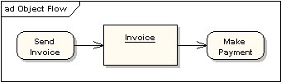

Object Flows and Pins
Invoice inv;
inv = new Invoice;
FillOrder(inv);
A shorthand notation: use input pins and output pins (parameters).

Slide 24
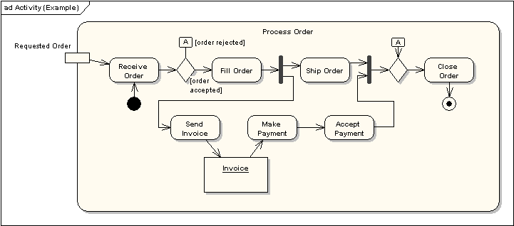
A Simple Example – Order Processing
activity parameter node = object node
<<precondition>> Order complete
<<postcondition>> Order closed
What if using swimlanes?

Slide 25
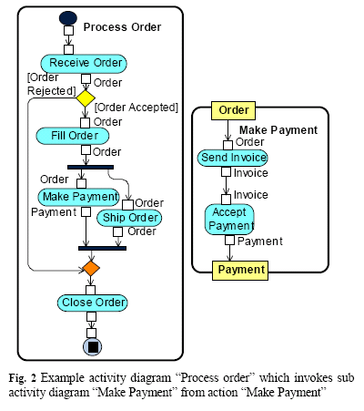
A Simple Example – Order Processing Using sub-activity
Is this the same as the previous one?

Slide 26
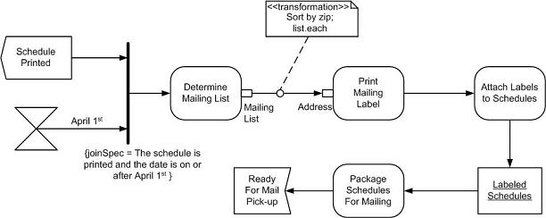
An Activity Diagram – Distributing schedules
http://www.agilemodeling.com/artifacts/activityDiagram.htm
<<signal>>
pin
parameter
redundant constraint
hour-glass symbol represents time
object
send
receive
send
receive

Slide 27
Interaction Overview Diagrams
Behavioral Diagrams
  Use case
  Statechart
  Activity
Interaction Diagrams
  Sequence;
  Communication
  Interaction Overview
  Timing

Slide 28
Interaction Overview Diagram (http://www.agilemodeling.com/artifacts/interactionOverviewDiagram.htm)
variants on UML activity diagrams which overview control flow.
The nodes within the diagram are frames, not activities
Two types of frame shown:
  interaction frames depicting any type of UML interaction diagram (sequence diagram: sd, communication diagram: cd, timing diagram: td , interaction overview diagram: iod )
  interaction occurrence frames (ref; typically anonymous) which indicate an activity or operation to invoke.
sd Enroll in Seminar lifelines :Student :Seminar :Course :Enrollment
ref
sd Determine Eligibility
Select Seminar()
:Student
:Seminar
:Course
{0..7msec}
[not eligible]
isEligible(std)
getPrereq ()
cd Determine Seat Availability
[seat available]
:Seminar
Number enrolled
:Enrollment
[no seat]
ref
AddToWaitingList()
ref
Enroll in Seminar()

Slide 29
Interaction Overview Diagram
sd Withdrawal
ref
Authenticate
PIN OK
PIN NOK
sd
sd
:User
:ATM
:Bank
:User
:ATM
withdraw
msg (“illegal entry”)
msg (“amount”)
amount (a)
chkAcct (a)
sd
sd
:User
:ATM
:Bank
:User
:ATM
:Bank
enough bal
not enough bal
money
msg(“amount too big”)
receipt
sd
:User
:ATM
Relationship with Sequence Diagram?
msg (“card”)

Slide 30
Timing Diagrams
Behavioral Diagrams
  Use case
  Statechart
  Activity
Interaction Diagrams
  Sequence;
  Communication
  Interaction Overview
  Timing

Slide 31
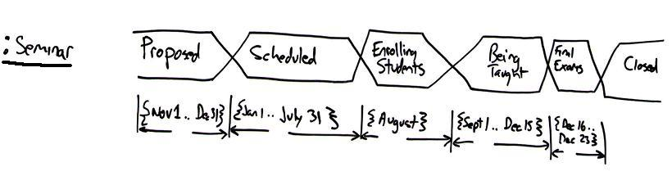
Interaction Diagram: Timing Diagram
To explore the behaviors of 0..* objects throughout a given period of time.
Two basic flavors: concise notation and robust notation
critical
states
Timing
constraints
The lifecycle of a single seminar
The critical states – Proposed, Scheduled, Enrolling Students, Being Taught, Final Exams, Closed
The two lines surrounding the states are called a general value lifeline.
When the two lines cross one another it indicates a transition point between states.
Timing constraints along the bottom of the diagram,
indicating the period of time during which the seminar is in each state.

Slide 32
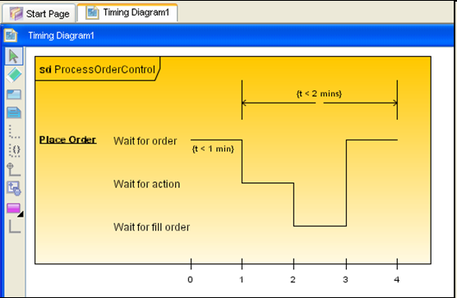
Interaction Diagram: Timing Diagram (robust notation)
http://www.visual-paradigm.com/highlight/highlightuml2support.jsp
states
state timeline
transition point
timing ruler w. tick marks
Can you transform this into a concise notation?

Slide 33
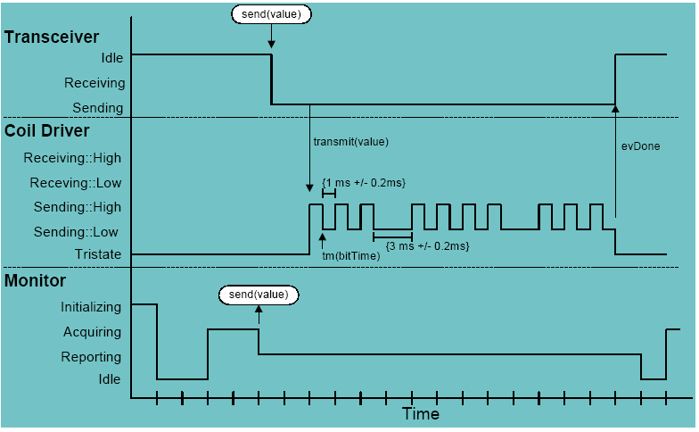
Timing Diagram – another example
(www.cs.tut.fi/tapahtumat/olio2004/richardson.pdf)

